Slide 1
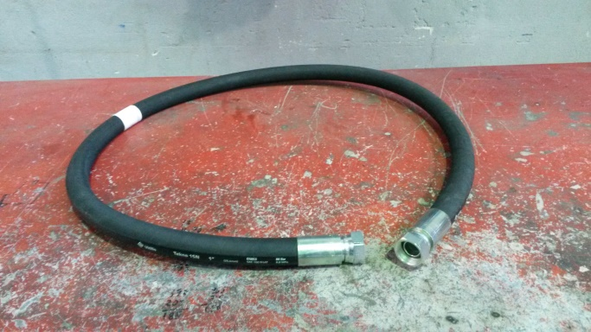
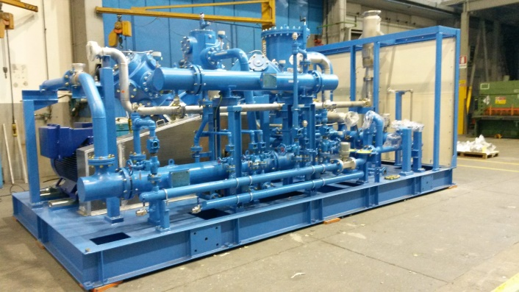
HS&E INCIDENT BULLETIN |  | 2nd half year 2017
Location Country: Italy | Type of incident : trauma for effort during assembly activities
Summary:
During tightening of 1’’ rubber flexible pipe with manual tool, the contractor operator felt pain on his left shoulder. The day after he went to First Aid of the Hospital where he was diagnosed a trauma for effort on his left shoulder.
Root Causes: | Actions Taken Thus Far: Next Steps
Tightening operations of interconnecting piping to compressor carried-out into the skid, where the accessibility is limited due the presence of pipes and of brackets; uncomfortable ergonomic conditions for the operator | verify assembly of components into the skid and eventually update the relative procedure in order to ensure right posture of the operators during fabrication; retraining of manufacturing operators and of contractors involved on manual handling of loads

